Slide 1
Relational Algebra
Dr. S. RENUKA DEVI
Associate Profesor
SCSE
VIT Chennai Campus

Slide 2
Introduction to Relational Algebra
Formal language for the relational model
Provides basic set of operations for the relational model
Enable a user to specify basic retrieval requests as relational algebra expressions
Its operations can be divided into two groups:
One group includes set operations from mathematical set theory – like union, intersection, set difference, and cartesian product
Other group consists of operations developed specifically for relational databases—like select, project, and join

Slide 3
Unary Relational Operations
Unary – operations performed on single relation
Select
Project
Select Operation
used to choose a subset of the tuples from a relation that satisfies a selection condition
Performs horizontal partition on the relation
In general, the SELECT operation is denoted by
where σ (sigma) is used to denote the SELECT operator
selection condition is a Boolean expression (condition) specified on the attributes of relation R

Slide 4
Select Operation
Example
select the EMPLOYEE tuples whose department is 4
select the EMPLOYEE tuples whose salary is greater than $30,000
Select the tuples for all employees who either work in department 4 and make over $25,000 per year, or work in department 5 and make over $30,000
In SQL, the SELECT condition is typically specified in the WHERE clause of a query

Slide 5
Project Operation
Selects certain columns from the table and discards the other columns
Performs vertical partition on the relation
The general form of the PROJECT operation is
where π (pi) is the symbol used to represent the PROJECT operation
<attribute list> is the desired sublist of attributes from the relation R
PROJECT operation removes any duplicate tuples

Slide 6

Project Operation
List each employee’s first name, last name and salary
In SQL, the PROJECT attribute list is specified in the SELECT clause of a query
E.g.,
Select Lname, Fname,Salary
From Employee

Slide 7

Sequences of Operations
It is possible to apply several relational algebra operations one after the other
E.g., Retrieve the first name, last name, and salary of all employees who work in department number 5
Both the select and project operation must be applied to get the result

Slide 8
Rename Operation
To rename the attributes of the relation
The general RENAME operation when applied to a relation R of degree n is denoted by any of the following three forms:
where ρ (rho) is used to denote the RENAME operator
S is the new relation name
B1, B2, ..., Bn are the new attribute names
Renaming in SQL is accomplished by aliasing using AS, as in the following example:
SELECT E.Fname AS First_name, E.Lname AS Last_name, E.Salary AS Salary
FROM EMPLOYEE AS E
WHERE E.Dno=5,

Slide 9
Set Theory Operations
Set theoretic operations are used to merge the elements of two sets in various ways, including union, intersection, and set difference
These are binary operations - applied on two relations
The two relations on which any of these three operations are applied must have the same type of tuples - union compatibility or type compatibility
Two relations R(A1, A2, ..., An) and S(B1, B2, ..., Bn) are said to be union compatible (or type compatible) if they have the same degree n and if dom(Ai) = dom(Bi) for 1 <= i <= n

Slide 10

Set Theory Operations
UNION: The result of this operation, denoted by R ∪ S, is a relation that includes all tuples that are either in R or in S or in both R and S. Duplicate tuples are eliminated
E.g.,
INTERSECTION: The result of this operation, denoted by R ∩ S, is a relation that includes all tuples that are in both R and S
SET DIFFERENCE : The result of this operation, denoted by R – S, is a relation that includes all tuples that are in R but not in S

Slide 11
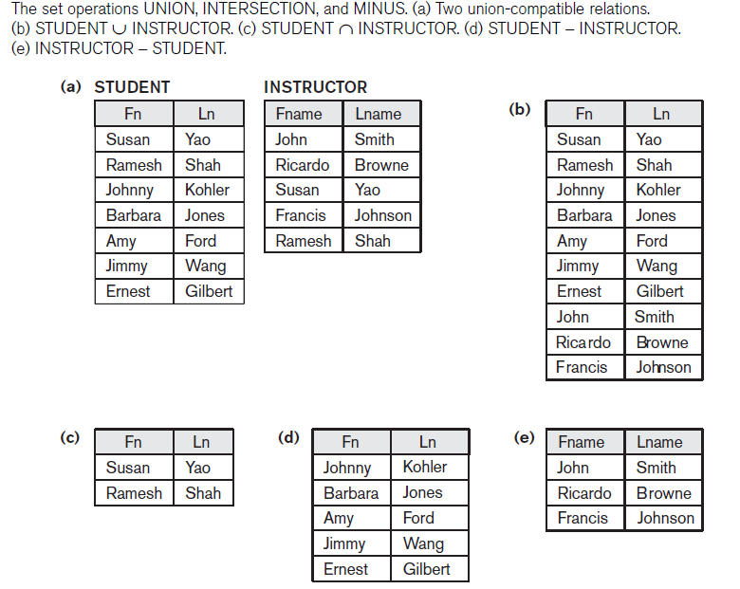

Slide 12
Cartesian Product Operation
Also known as cross product or cross join
Denoted by ×
This is also a binary set operation, but the relations on which it is applied do not have to be union compatible
E.g.,

Slide 13
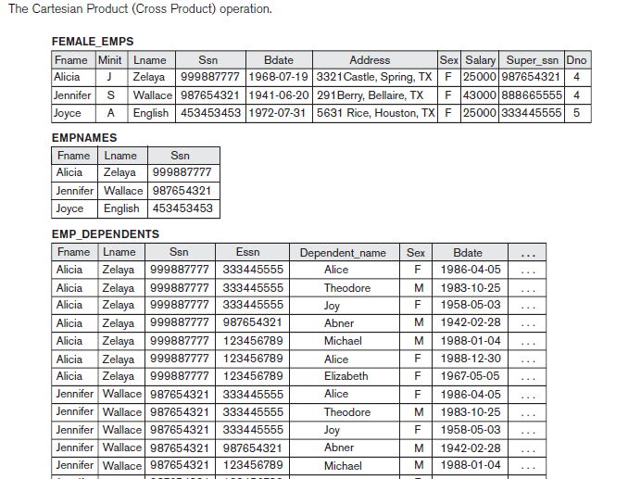

Slide 14

Binary Relational Operations
Join Operation( )
used to combine related tuples from two relations into single “longer” tuples
The general form of a JOIN operation on two relations R(A1, A2, ..., An) and S(B1, B2, ..., Bm) is
E.g.,

Slide 15
Variations of Join
Equi Join - involves join conditions with equality comparisons only
Natural Join -requires that the two join attributes have the same name in both relations
Denoted by *
E.g,

Slide 16

Division Operation
The DIVISION operation, denoted by ÷, is useful for a special kind of query that sometimes occurs in database applications
For example: Retrieve the names of employees who work on all the projects that ‘John Smith’ works on
To express this query using the DIVISION operation, follow the procedure below:
First, retrieve the list of project numbers that ‘John Smith’ works on in the intermediate relation SMITH_PNOS:

Slide 17

Division Operation
Create a relation that includes a tuple <Pno, Essn> whenever the employee whose Ssn is Essn works on the project whose number is Pno in the intermediate relation SSN_PNOS
Finally, apply the DIVISION operation to the two relations, which gives the desired employees’ Social Security numbers:

Slide 18
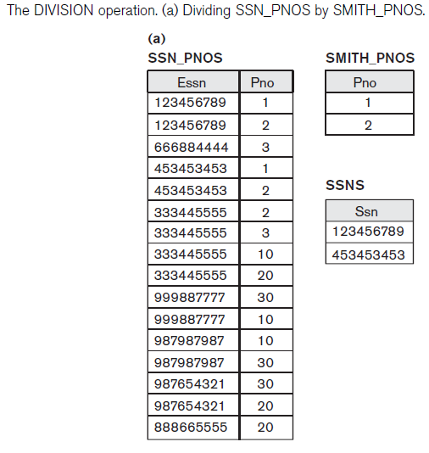

Slide 19

Additional Relational Operations
Generalized Projection
The generalized projection operation extends the projection operation by allowing functions of attributes to be included in the projection list
The generalized form can be expressed as:
where F1, F2, ..., Fn are functions over the attributes in relation R and may involve arithmetic operations and constant values
This operation is helpful when developing reports where computed values have to be produced in the columns of a query result

Slide 20
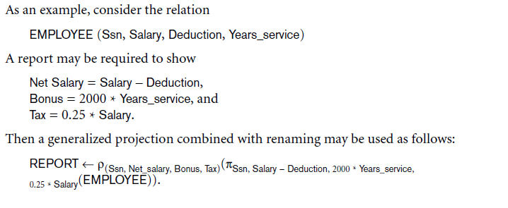
Generalized Projection

Slide 21

Aggregate Functions and Grouping
Common functions applied to collections of numeric values include SUM, AVERAGE, MAXIMUM, MINIMUM and COUNT
We can define an AGGREGATE FUNCTION operation, using the symbol ℑ
where <grouping attributes> is a list of attributes of the relation specified in R
<function list> is a list of (<function> <attribute>) pairs <function> is one of the allowed functions—such as SUM, AVERAGE, MAXIMUM, MINIMUM,COUNT <attribute> is an attribute of the relation specified by R

Slide 22

Aggregate Functions and Grouping
For example, Retrieve each department number, the number of employees in the department, and their average salary

Slide 23
Outer Join Operations
OUTER JOINS - developed for the case where the user wants to keep all the tuples in R, or all those in S, or all those in both relations in the result of the JOIN, regardless of whether or not they have matching tuples in the other relation
LEFT OUTER JOIN ( ) operation keeps every tuple in the first, or left, relation R in R S; if no matching tuple is found in S, then the attributes of S in the join result are filled or padded with NULL values
RIGHT OUTER JOIN, denoted by , keeps every tuple in the second, or right, relation S in the result of R S
FULL OUTER JOIN, denoted by , keeps all tuples in both the left and the right relations when no matching tuples are found, padding them with NULL values as needed

Slide 24
Any Queries?

